Slide 1
Pre-defense Committee Meeting
Dec 17, 2013

Slide 2
Outline
Introduction
Chapter I: Elevated pCO₂ causes developmental delay in early larval Pacific oysters
Chapter II: Shotgun proteomics as a viable approach for biological study in Pacific oysters
Chapter III: From shell deposition to protein expression: An integrative assessment of ocean acidification impacts on a marine invertebrate
Chapter IV?
Conclusions

Slide 3
Work from France: Chapter IV?
Same samples as chapter III – oysters exposed to elevated pCO₂ (400, 1000, 2800 µatm) for 1 month
Half the samples were ruined – small sample sizes
Possible perspective – insights from proteomics lead us to investigate potential biomarker assays

Slide 4
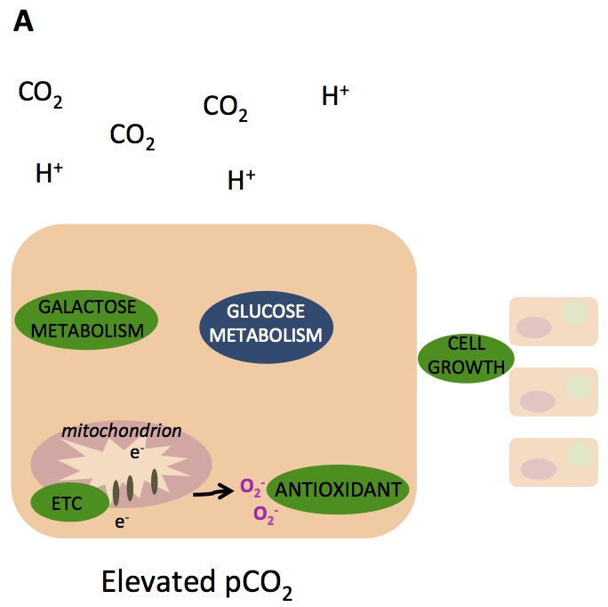
Antioxidant Enzymes
I saw evidence of an antioxidant response in my proteomics work
Does protein expression translate to enzymatic activity?

Slide 5
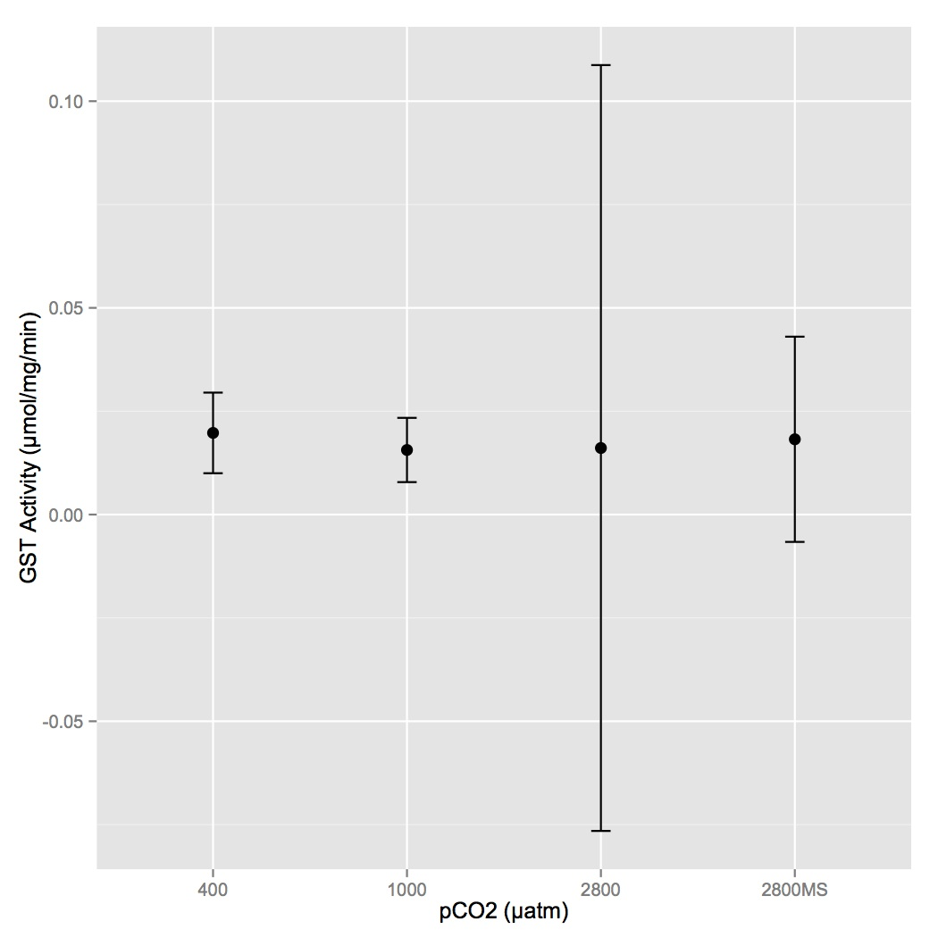
Antioxidant Enzymes
n=2
n=2
n=4
Glutathione S-transferase
n=4
Notes:
Global activity – all isoforms
Detoxification but also has roles in antioxidant response

Slide 6
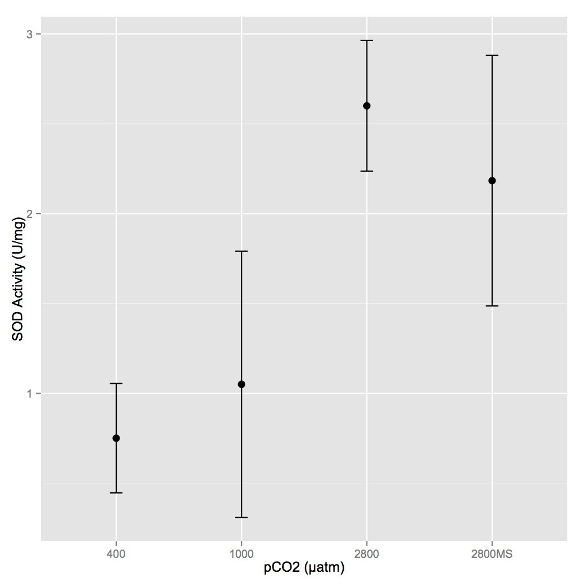
Antioxidant Enzymes
n=6
n=6
B
n=4
Superoxide dismutase
B
n=4
A
A
Notes:
ROS scavenger

Slide 7
AMPKα background
AMP-activated protein kinase
Changes expression in response to metabolic stresses – there were changes in metabolic pathways in proteomics
Activated via phosphorylation
Truncated form may be important in stress response

Slide 8
AMPKα background
Characterized in 2 studies by Guévélou et al. (2013)
In gonad, the expression of the full-length varies with reproductive stage
In smooth muscle, the expression of the truncated changes quickly upon exposure to hypoxia

Slide 9
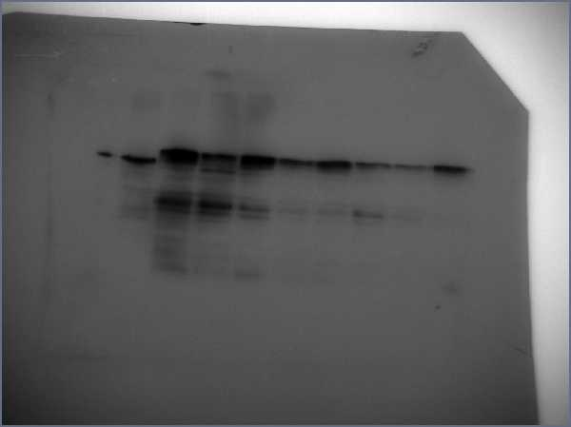
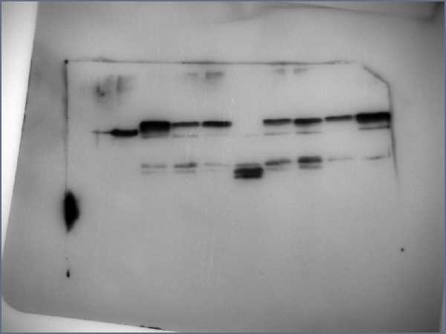
Full-Length AMPKα
400 µatm
1000 µatm
2800 µatm
Gel 1
P = 0.06 for 400 vs. 2800 µatm
Gel 2
“Truncated” AMPKα
400 µatm
1000 µatm
2800 µatm
Gel 1
No difference among treatments
Gel 2

Slide 10
AMPKα
Antibody for AMPK protein
What is interesting? Patterns are different from those seen in other oyster tissues.
  Phosphorylation of both total and truncated form
  Absence of total that is present in gonad and muscle?

Slide 11
Glycogen Assay
We’re working on it

Slide 12
Proposed Timeline
Draft of dissertation to committee by January 10
Defense scheduled for week of February 10

Slide 13
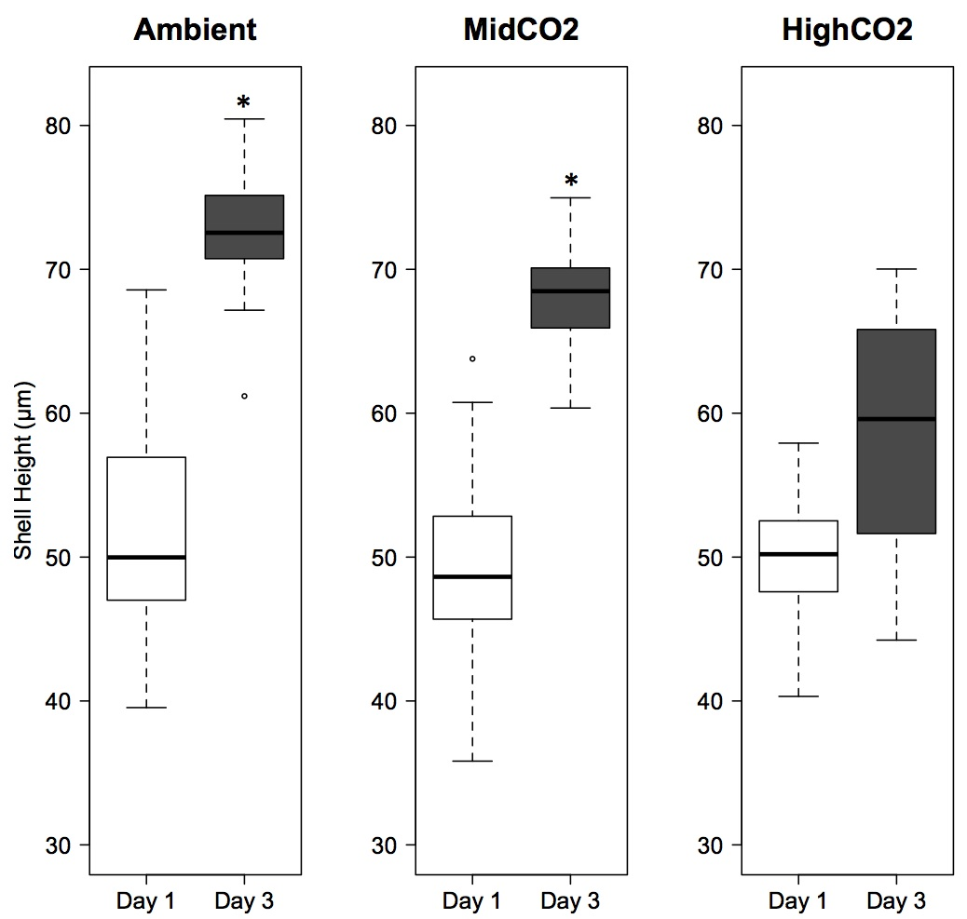
Chapter I
Notes:
No difference in size day 1, oysters grew less at highCO2 day 3

Slide 14
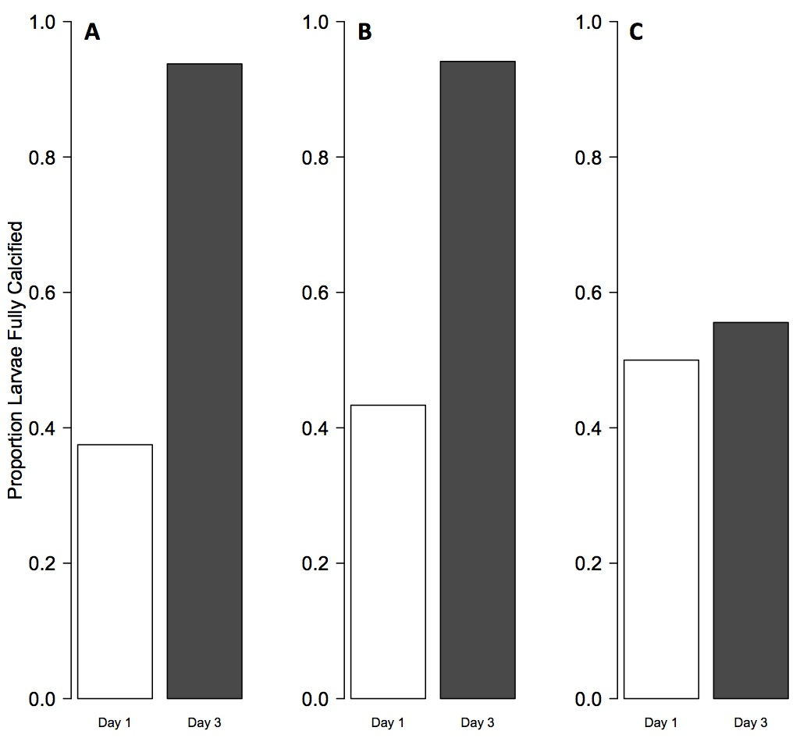
Chapter I
Notes:
Same pattern with calcification

Slide 15
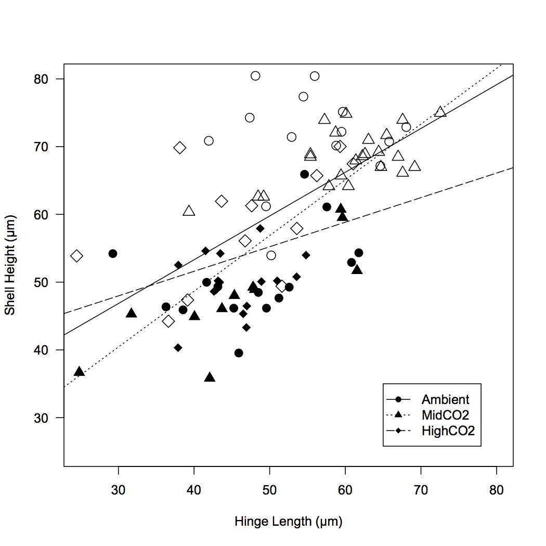
Chapter I
Notes:
Developmental delay – highCO2 larvae maintain same allometry but do not grow as fast

Slide 16
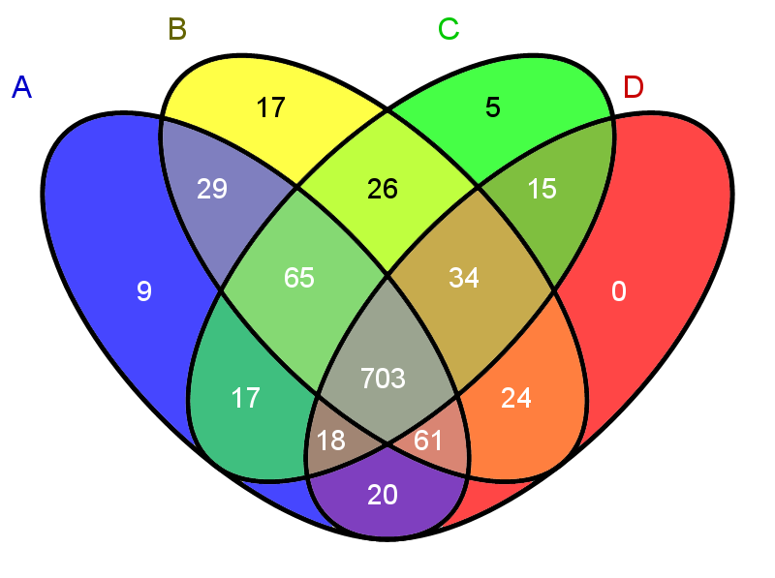
Chapter II

Slide 17
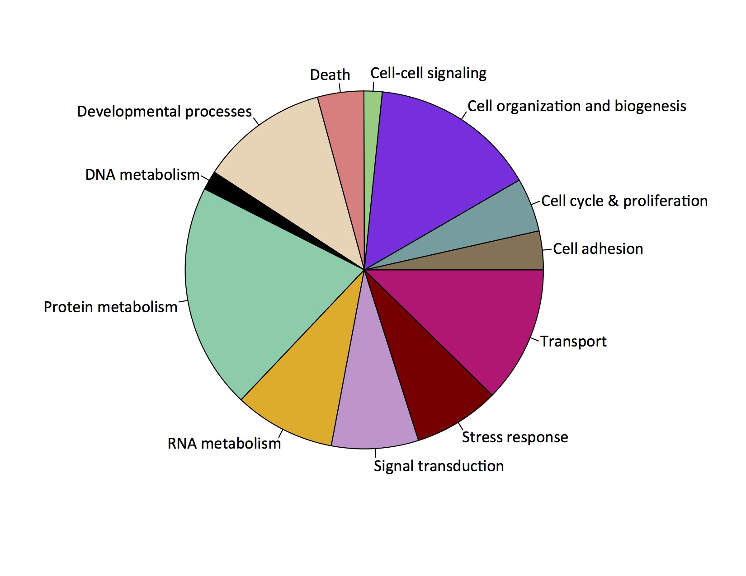
Chapter II

Slide 18
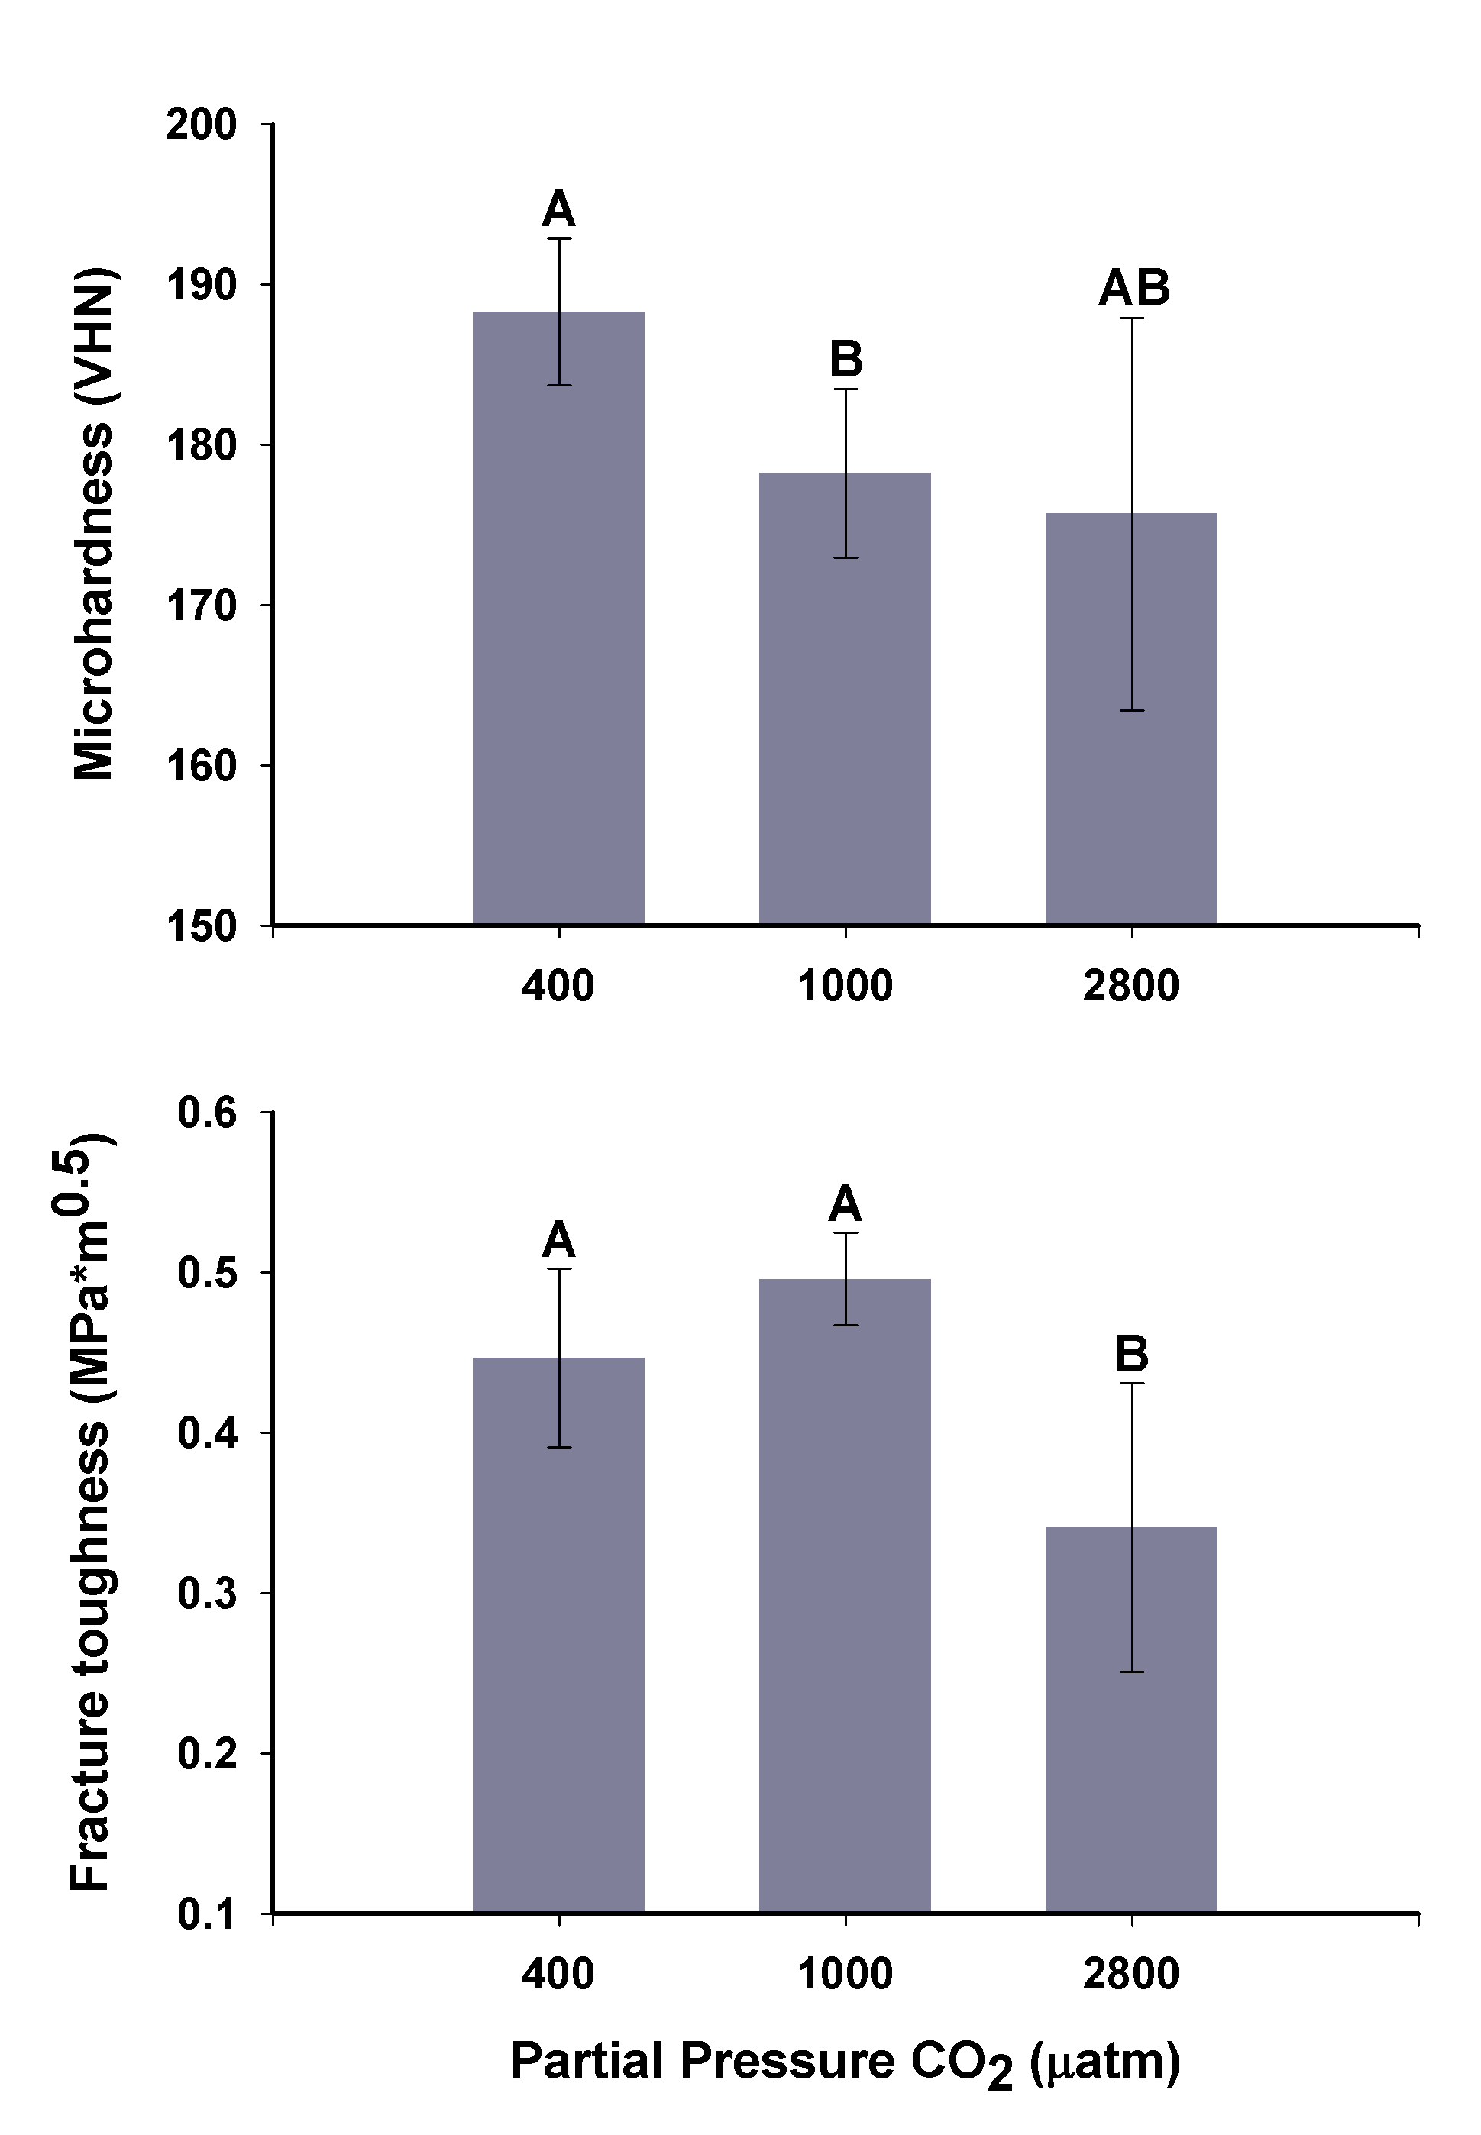
Chapter III

Slide 19
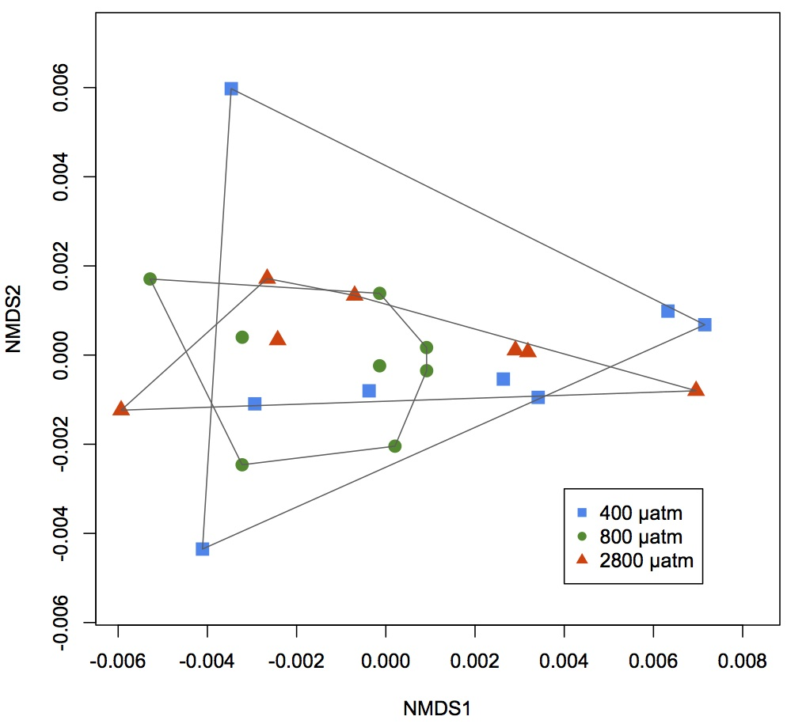
Chapter III

Slide 20
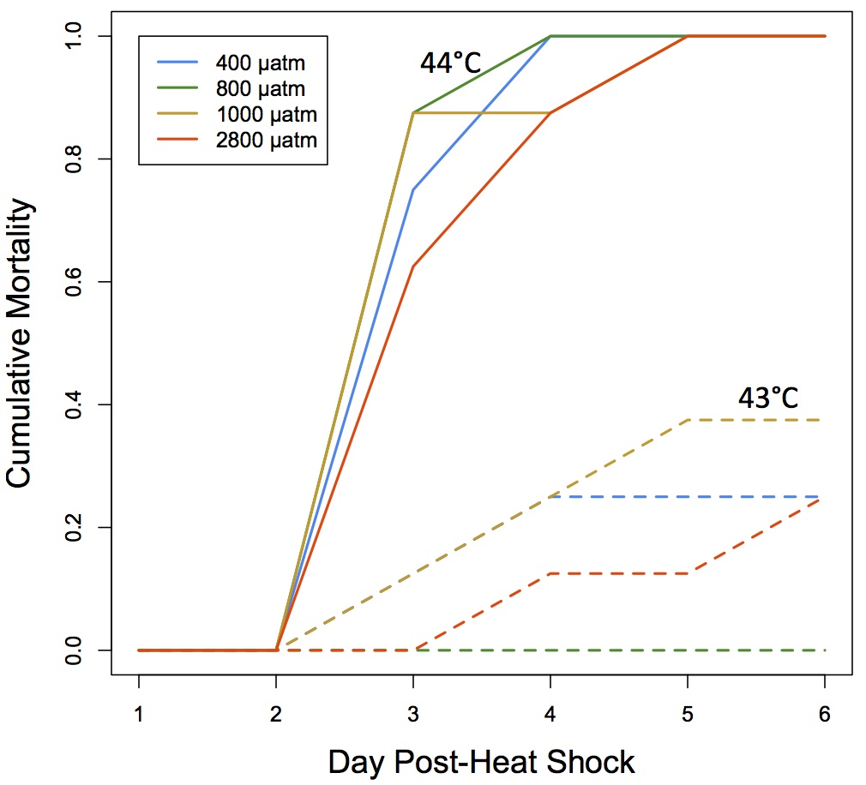
Chapter III

Slide 21
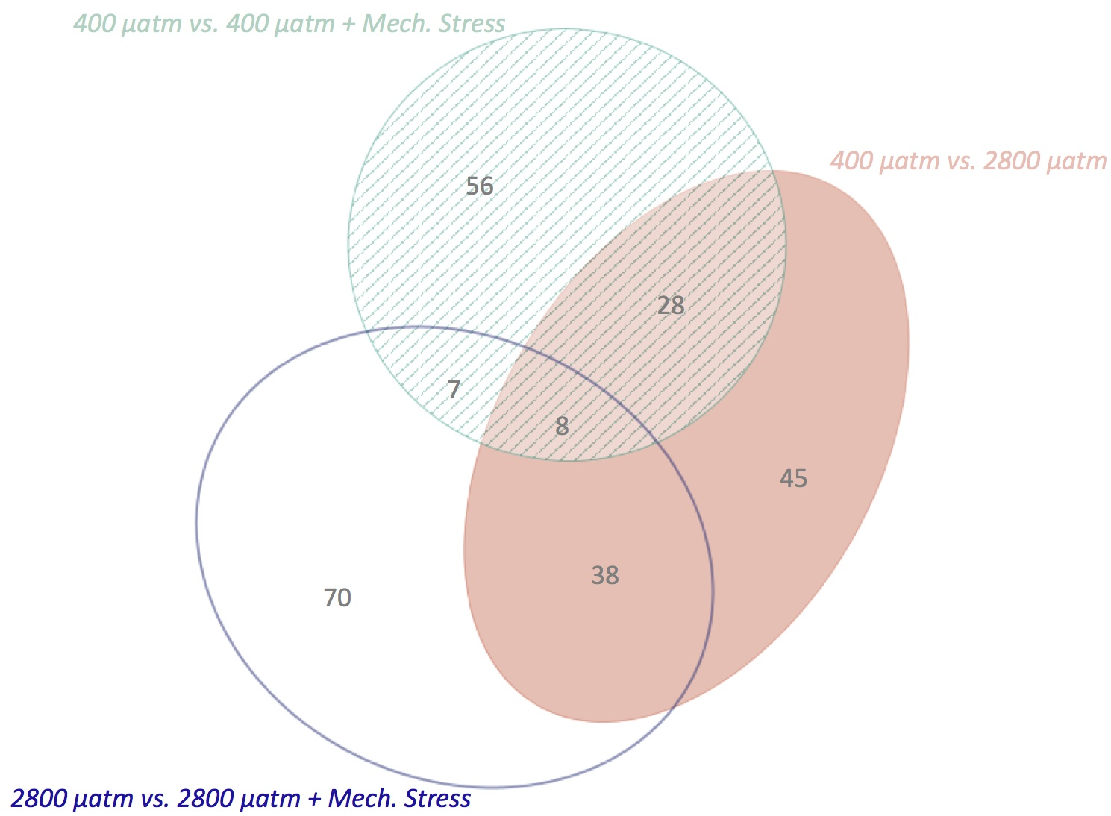
Chapter III

Slide 22
Chapter III

